Slide 1

Resonance Website Dibimbing
Adryn Ivanna Toban

Slide 2



Overview Project
Resonance Website Project (Finpro)
(06 oct - 26 oct 25)
Adryn Ivanna Toban
The Resonance Dibimbing Website is an online platform for managing user interactions, ticket submissions, and support communication.
This QA project ensures all website features meet functional and quality standards through manual and automated testing.
The goal is to validate system stability, usability, and reliability guaranteeing a seamless, bug-free user experience before release.
Education
Bachelor of Industrial Engineering at Atma Jaya Yogyakarta University
Working
-Procurement at Pura Barutama (Feb 23 - Aug 23)
-PPIC at PT Duniatex (Sep 23 - May 24)

Slide 3
Problem Statement

Slide 4
Problem Statement:
Execute all manual test cases to ensure that all features function properly without errors or bugs.
Ensure that UI testing shows no display inconsistencies, especially when incorrect data is entered. Previously, during exploratory testing while attempting to log in, the notification message was not specific enough to indicate that the password was incorrect, which could confuse users.
Ensure that the Create Ticket feature can be fully utilized; previously, a bug was found where the user failed to upload an image.
Perform automated end-to-end testing to improve testing efficiency and ensure there are no errors when the website is launched.

Slide 5
Requirement & Test Plan

Slide 6
TEST PLAN SUMMARY
Project: Website Resonance Dibimbing
URL: https://resonance.dibimbing.id/login
Objective:
Validate that all website features function according to the agreed quality standards,
identify and close all detected bugs to ensure system stability before release.
Scope of Testing:
Comprehensive testing of Login process, User dashboard,Ticket creation & submission,Sorting and date filtering features
Types of Testing:
✅ Normal Test: Verify expected user behavior
⚠ Negative Test: Check invalid input handling
🔁 Regression Test: Confirm existing features work after updates
🔗 API Test: Validate response and data flow
⚡ Load & Performance Test: Assess speed and stability
Testing Strategy:
Use both Manual and Automation Testing approaches to ensure: Functional accuracy, System performance, User reliability
Testing Schedule:
06 – 26 October 2025
Includes test case creation, execution, bug fixing, and final validation.
Tools & Platforms:
GitHub · Google Docs · Excel · Postman · IntelliJ IDEA · Resonance Website
Criteria:
Entry: Requirements approved, stable environment ready
Exit: All test cases executed, no open critical bugs
QA: Adryn Ivanna Toban
Risk | Mitigation
Sudden feature changes | Close coordination with dev team
Build delays | Early testing on staging
Limited regression time | Use automated regression scripts

Slide 7
Manual Testing

Slide 8
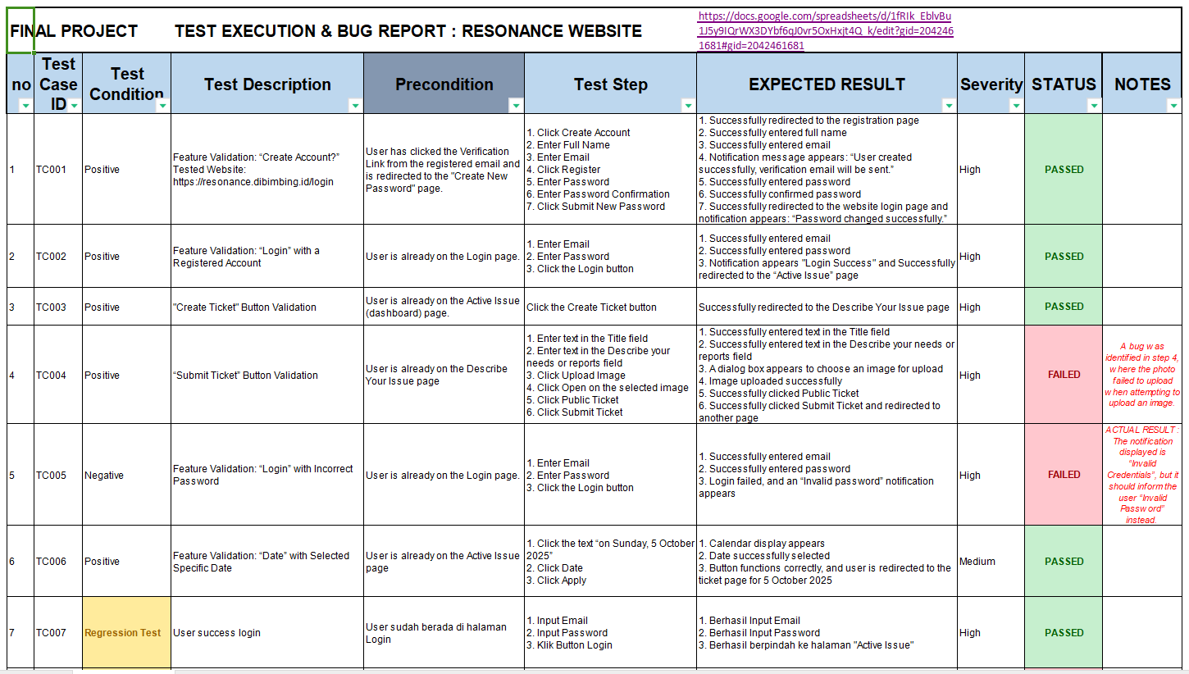

Slide 9
Automation Testing

Slide 10
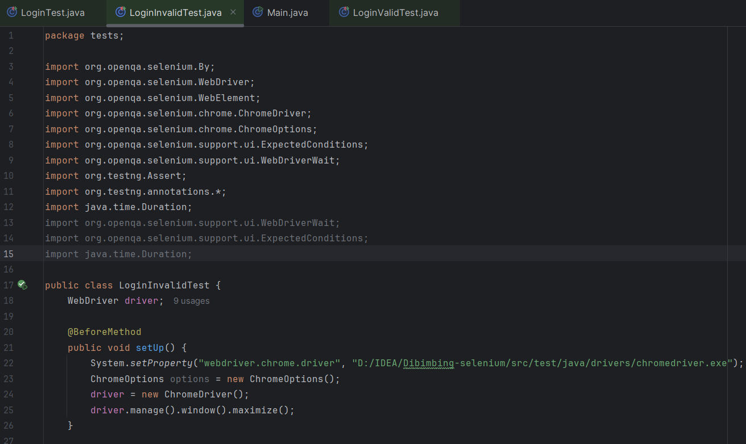
Invalid Login Test
Before Method

Slide 11
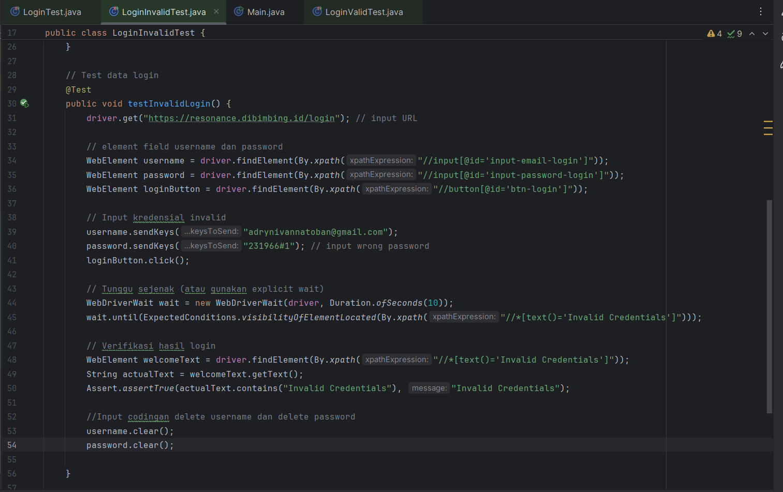
Test Data Login

Slide 12
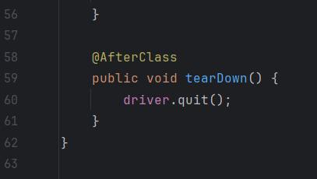
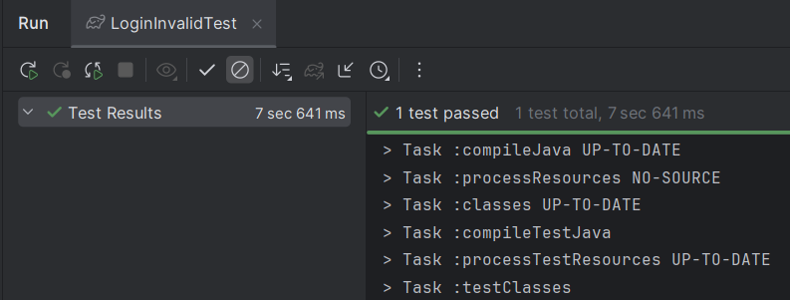
After Class

Slide 13
Regression & Compatibility Testing

Slide 14
Bagian yang menjelaskan hasil regression testing untuk memastikan perubahan tidak merusak fungsionalitas lama, serta hasil cross-browser testing untuk menjamin konsistensi aplikasi pada berbagai browser atau device.

Slide 15
Reporting & Dashboard

Slide 16
Bagian yang menyajikan rangkuman defect berdasarkan tingkat keparahan (severity) dan status. Jika memungkinkan, tambahkan visualisasi berupa grafik atau tabel untuk memperjelas hasil pengujian.

Slide 17
Conclusion & Recommendation

Slide 18
Bagian yang merangkum temuan utama dari pengujian, defect paling kritis, serta rekomendasi QA untuk meningkatkan kualitas aplikasi dan arah pengembangan pengujian ke depan.

Slide 19
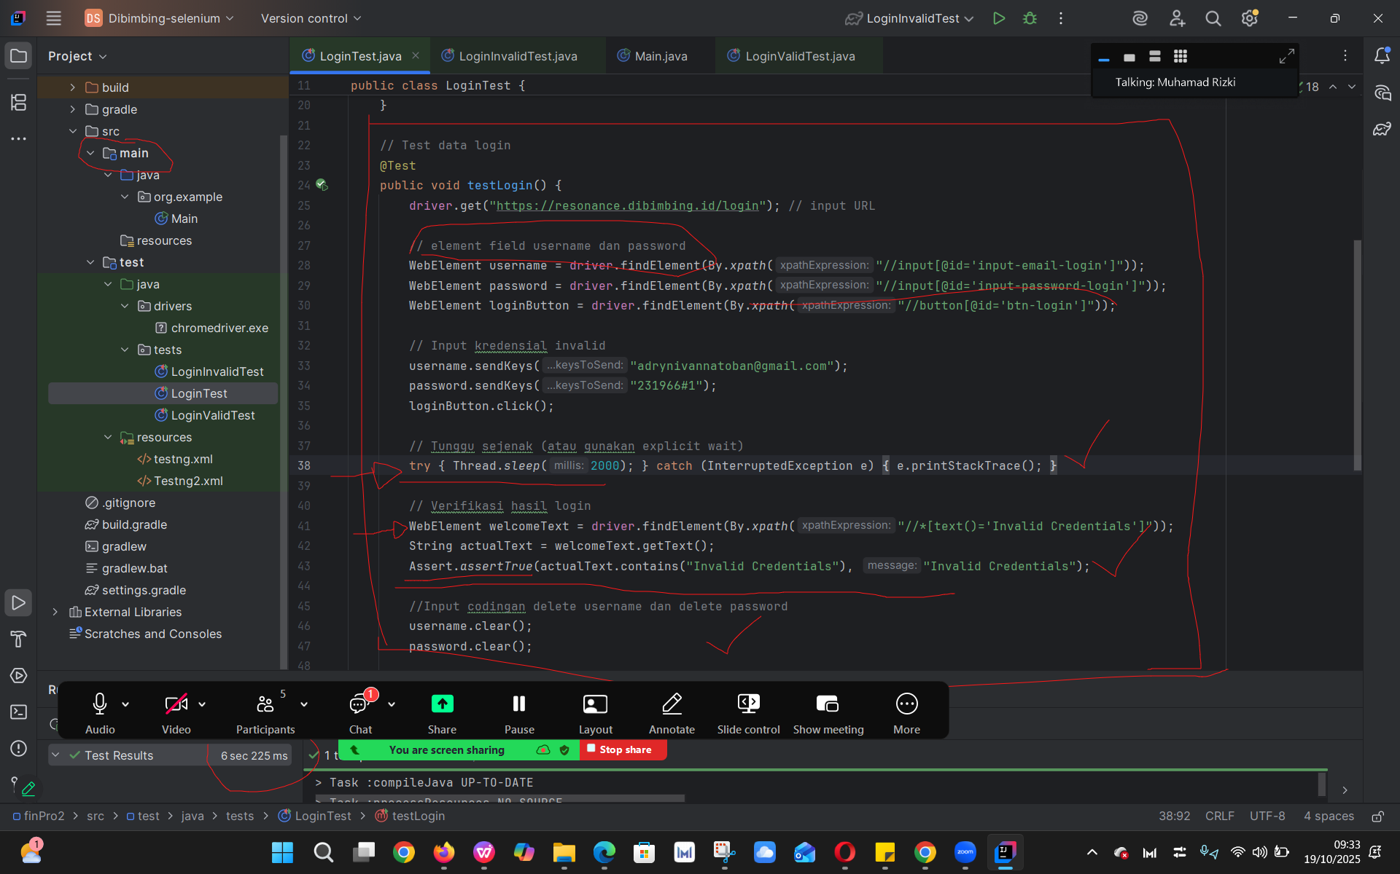

Slide 20


Terima
Kasih.

